Slide 1

INT220 SERVER SIDE SCRIPTING
Lecture #0
The kick start session

Slide 2
Vision
To be a globally recognized school through excellence in teaching, learning and research for creating Computer Science professionals, leaders and entrepreneurs of future contributing to society and industry for sustainable growth.

Slide 3
Mission
To build computational skills through hands-on and practice-based learning with measurable outcomes.
To establish a strong connect with industry for in-demand technology driven curriculum.
To build the infrastructure for meaningful research around societal problems.
To nurture future leaders through research-infused education and lifelong learning.
To create smart and ethical professionals and entrepreneurs who are recognized globally

Slide 4
Course details
LTP – 2 0 2
Credit – 3

Slide 5
Assessment/Evaluation Scheme
Attendance: 5
CA: 45
ETP: 50

Slide 6
Complete evaluation criteria for the course
CA1: 30 marks (Visual Implementation -VI)
To assess the student’s skills in PHP Fundamentals, Arrays and Functions.
CA2: 30 marks (Visual Implementation –VI)
To assess the student’s skills in PHP forms , PHP cookies, sessions and string handling.
CA3: 30 marks (Project)(Compulsory)
To access the student’s web designing skills.
CA1 and CA2 (best 1 out of 2)

Slide 7
CA 3 – Project rubrics
Functionality and Deployment(5),
User Interface(5),
Novelty/Uniqueness(5),
Documentation(5),
Presentation(5),
Client Involvement(5)
NOTE:- Client involvement depicts the revenue generated by the students through the client. Students will be required to submit the proof of revenue generation

Slide 8
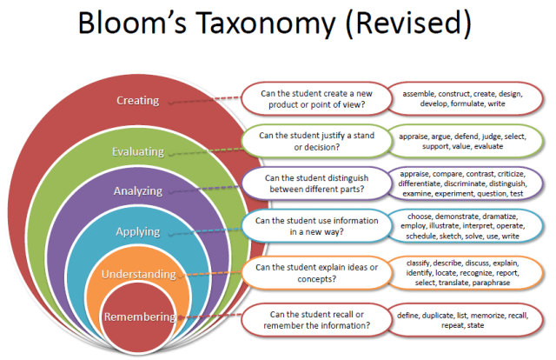
Revised Bloom’s Taxonomy

Slide 9
Course outcome
Through this course students should be able to:
CO1 :: employ web development concepts including server setup and basic programming syntax
CO2 :: use PHP arrays and functions to enhance web development efficiency.
CO3 :: develop PHP form handling, validation, and sanitization techniques for secure data processing.
CO4 :: employ PHP techniques for enhanced web functionality, encompassing cookies, sessions.
CO5 :: apply object-oriented programming principles in PHP for enhanced code organization and functionality. CO6 :: demonstrate proficiency in MySQL fundamentals including database basics, SQL queries and functions.

Slide 10
Program Outcomes
PO1 Engineering knowledge: Apply the knowledge of mathematics, science, engineering fundamentals, and an engineering specialization to the solution of complex engineering problems.
PO2 Problem analysis::Identify, formulate, research literature, and analyze complex engineering problems reaching substantiated conclusions using first principles of mathematics, natural sciences, and engineering sciences.
PO3 Design/development of solutions::Design solutions for complex engineering problems and design system components or processes that meet the specified needs with appropriate consideration for the public health and safety, and the cultural, societal, and environmental considerations.
PO4 Conduct investigations of complex problems::Use research-based knowledge and research methods including design of experiments, analysis and interpretation of data, and synthesis of the information to provide valid conclusions.

Slide 11
Program Outcomes
PO5 Modern tool usage::Create, select, and apply appropriate techniques, resources, and modern engineering and IT tools including prediction and modeling to complex engineering activities with an understanding of the limitations.
PO6 The engineer and society::Apply reasoning informed by the contextual knowledge to assess societal, health, safety, legal and cultural issues and the consequent responsibilities relevant to the professional engineering practice.
PO7 Environment and sustainability::Understand the impact of the professional engineering solutions in societal and environmental contexts, and demonstrate the knowledge of, and need for sustainable development.
PO8 Ethics::Apply ethical principles and commit to professional ethics and responsibilities and norms of the engineering practice.
PO9 Individual and team work::Function effectively as an individual, and as a member or leader in diverse teams, and in multidisciplinary settings.

Slide 12
Program Outcomes
PO10 Communication::Communicate effectively on complex engineering activities with the engineering community and with society at large, such as, being able to comprehend and write effective reports and design documentation, make effective presentations, and give and receive clear instructions.
PO11 Project management and finance::Demonstrate knowledge and understanding of the engineering, management principles and apply the same to one’s own work, as a member or a leader in a team, manage projects efficiently in respective disciplines and multidisciplinary environments after consideration of economic and financial factors.
PO12 Life-long learning::Recognize the need for, and have the preparation and ability to engage in independent and life-long learning in the broadest context of technological change.

Slide 13
Course contents
Unit I
PHP Fundamentals : PHP, MySQL and XAMPP Installation, PHP Basic Syntax, PHP Data Types, PHP Variables, PHP Constants, PHP Expressions, PHP Operators, PHP Control Structures, PHP Loops

Slide 14
Course contents
Unit II
PHP Arrays and Functions : PHP Enumerated Arrays, PHP Associative Arrays, PHP Multi-Dimensional Arrays, PHP Functions, Syntax, Arguments and Variables, References, Pass by Value & Pass by references, Return Values, Variable Scope, PHP include() and PHP require()

Slide 15
Course contents
Unit III
PHP Forms : PHP Form handling, PHP GET and POST, PHP Form Validation, PHP Form Sanitization

Slide 16
Course contents
Unit IV
PHP Cookies, Sessions and Strings Handling : PHP Cookie Handling, PHP Session Handling, PHP Login Session, Strings and Patterns, Matching, PHP Sending Emails, PHP File Uploading, PHP Filters, PHP Error Handling

Slide 17
Course contents
Unit V
Object Oriented Programming in PHP : Defining PHP Classes, Creating Objects in PHP, Calling Member Functions, Constructor Functions, Inheritance, Function Overriding, Interface, Abstract Classes

Slide 18
Course contents
Unit VI
Basic MySQL and SQL Queries : Database Basics, Indexes, PHP MyAdmin, Connect & Pconnect, MySQL Create, MySQL Insert, MySQL Select, MySQL Update, MySQL Delete, MySQL Truncate, MySQL Drop, WHERE condition, Order By and Group By, Having, LIKE, AND OR operators, SQL functions AVG, COUNT, SUM, MIN, MAX, LCASE, UCASE

Slide 19
List of practical
Installation and configuration of XAMPP Web Server, PHP and MySQL.
Use data types of PHP including String, Integer, Float, Boolean, Array, Object and Resource.
Use Constants in PHP and make them global.
Use Various types of operators including Arithmetic, Assignment, Comparison, Increment/Decrement, Logical, String and array operators.
Use PHP control structures - if, if...else, if...elseif.else, switch statement and Loops.

Slide 20
List of practical
Implement the concept of two-dimensional arrays.
Create a user-defined function in PHP, PHP function arguments, and various types for passing arguments in functions- call by value, call by reference.
Use of PHP include and require statements.
Design HTML forms with PHP including validations using GET and POST.
Use the concept of PHP cookies, sessions and strings handling including filter functions.
Use object oriented concepts in PHP
Use the file handling functions.
Design a Web Page with database connectivity using MySQL and PHP

Slide 21
Text & Reference Books
Text Books:
UNLOCK PHP 8: FROM BASIC TO ADVANCED by RONI SOMMERFELD, BPB PUBLICATIONS.
References:
PHP BEGINNERS PRACTICAL GUIDE by PRATIYUSH GULERIA, BPB PUBLICATIONS

Slide 22
Softwares
Editor-VS-Code
Local Web Server-XAMPP

Slide 23
MOOCs/Competition
Building Web Applications in PHP:
https://www.coursera.org/learn/web-applications-php

Slide 24
Open Education Resources
https://www.w3schools.com/php/php_install.asp
https://www.tutorialrepublic.com/php-tutorial/php-arrays.php
https://www.youtube.com/watch?v=bOqTCDfc7Tk
https://www.tutorialrepublic.com/php-tutorial/php-form-validation.php
https://www.youtube.com/watch?v=UZcVUfaby9U
https://www.php.net/manual/en/language.oop5.php
https://www.coursera.org/learn/database-applications-php?irclickid=XLt0rjwQOxyPWfrTyQuvwH6UkC0VgQTm1o9zw0&irgwc=1&utm_medium=partners&utm_source=impact&utm_campaign=315774&utm_content=b2c#modules

Slide 25

Jump Board Initiatives
to
foster your
DREAM CAREER

Slide 26

B2B : Need
Forgetfulness
Lack of clarity of concepts
Limited Retention
Uneven association of basic to advance
Reading – A dying habit
What to revise?
One shoe size does not fit all

Slide 27

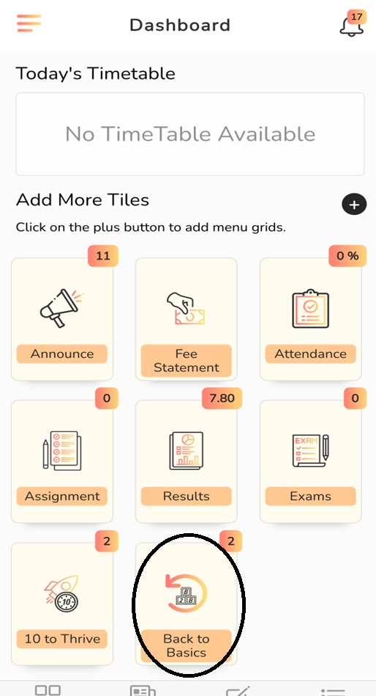
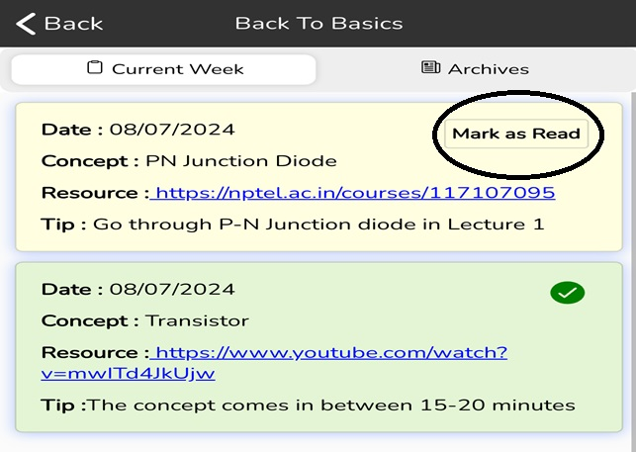
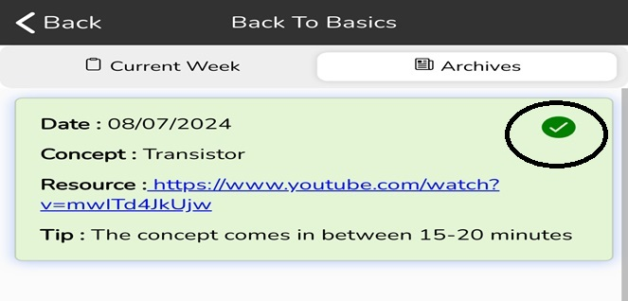
B2B : Construct

Slide 28
B2B : Construct

Slide 29
B2B : Construct

Slide 30

B2B : Blueprint
Two reading/watching links every week
Monthly practice test from the content covered in the month
Final B2B test along with ETE
Capturing the learning and assimilating it in SMART

Slide 31

Ten to Thrive : Need
Missing Breadth
Inability to comprehend
Lack of expression
Missing crispness
Unable to pitch to the point
Public speaking fear

Slide 32
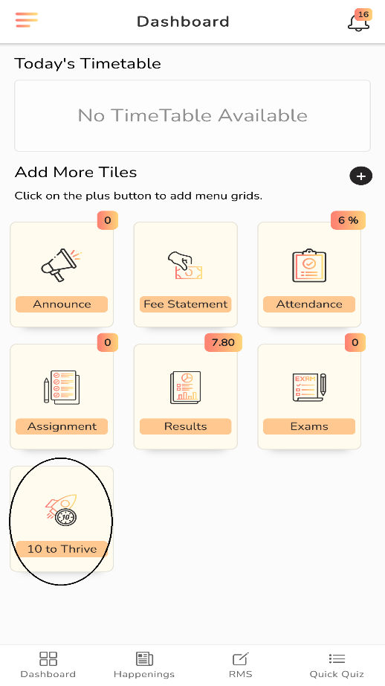
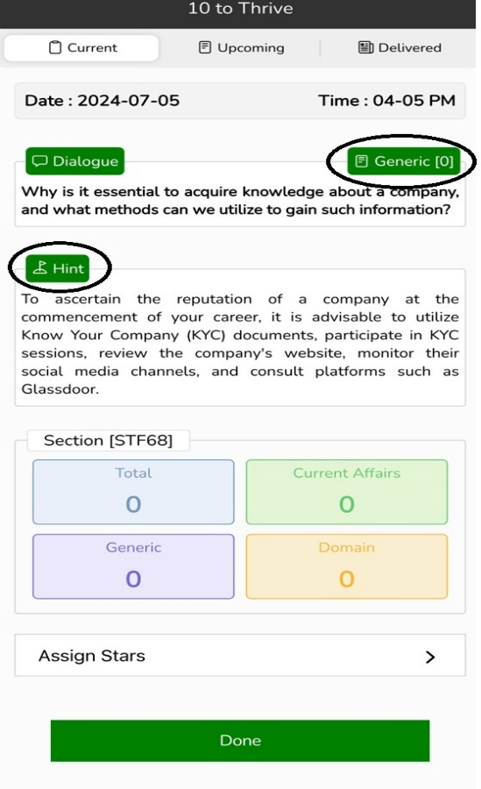
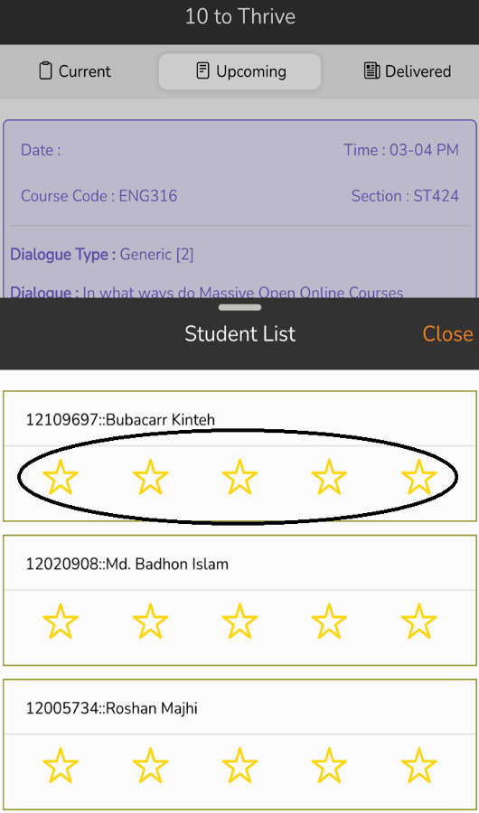
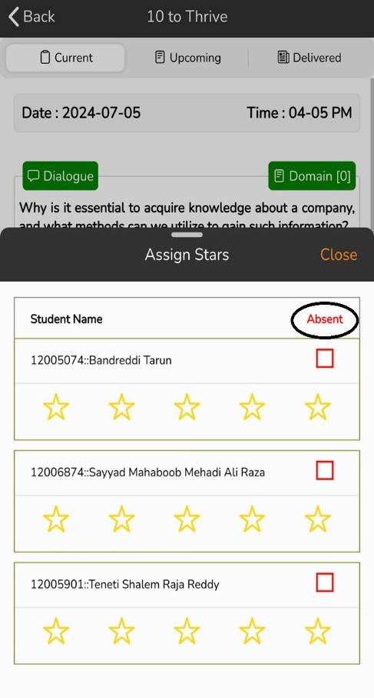
TTT : Construct

Slide 33

TTT : Construct

Slide 34
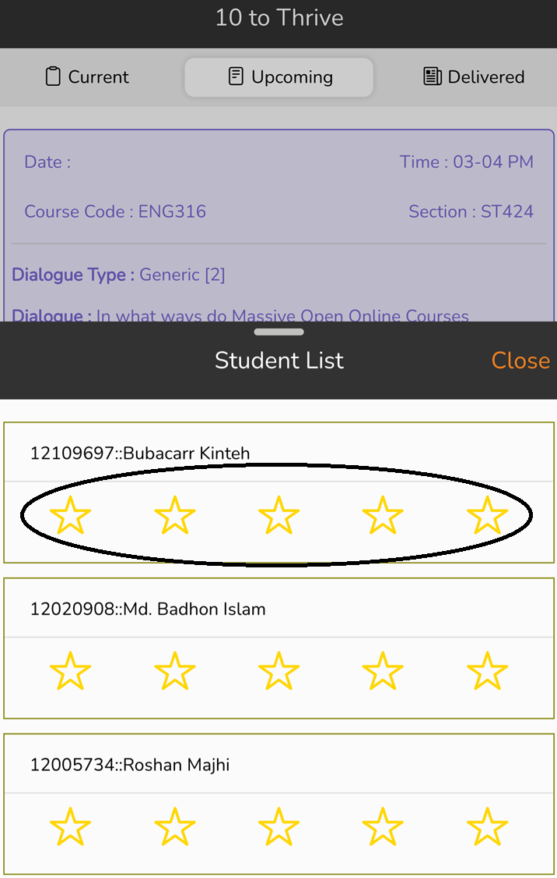
TTT : Construct

Slide 35

TTT : Blueprint
Dialogue will be visible 2 days in advance to prepare well
Three realms of dialogue
Domain
Generic
Current Affairs
Pitch in 3 minutes only
No PPT, Notes or any other reference material
Stars from 0 to 5 based on preparedness, confidence, coherence, fluency and timely accomplishment
A student will get 6 chances in a term, 4 best would be counted
One of the game elements for PO - I

Slide 36
Next Class: Introduction to PHP

Slide 37
Introduction
PHP stands for Hypertext Preprocessor.
It is a very popular and widely-used open source server-side scripting language to write dynamically generated web pages.
It was originally created by Rasmus Lerdorf in 1994.
It was initially known as Personal Home Page.

Slide 38
Introduction(Conti..)
Versions:
PHP Version 1.0
PHP Version 2.0
PHP Version 3.0
PHP Version 4.0
PHP Version 5.0
PHP Version 6.0
PHP Version 7.0
PHP Version 8.0 -> 8.3
For more information, check :
https://php.watch/versions

Slide 39
Introduction(Conti..)
A PHP interpreter, which can be implemented as a module, is commonly used to process PHP code on a web server.
The outcome of the interpreted and executed PHP code – which is an HTML data, CSS, JavaScript, images – would make up the entirety or portion of an HTTP response on a web server.
PHP scripts are executed on the server and the result is sent to the web browser as plain HTML.
PHP can be integrated with the number of popular databases, including MySQL, Oracle, Microsoft SQL Server, Sybase, and so on.
PHP files have extension ".php"

Slide 40

Introduction(Conti..)
ele”PHP”ant

Slide 41
What you can do with PHP
You can generate pages and files dynamically.
You can create, open, read, write and close files on the server.
You can collect data from a web form such as user information, email, phone no, etc.
You can send emails to the users of your website.
You can send and receive cookies to track the visitor of your website.
You can store, delete, and modify information in your database.
You can restrict unauthorized access to your website.
You can encrypt data for safe transmission over internet

Slide 42
Advantages over other languages:
Easy to learn: PHP is easy to learn and use. For beginner programmers who just started out in web development, PHP is often considered as the preferable choice of language to learn.
Open source: PHP is an open-source project. It is developed and maintained by a worldwide community of developers who make its source code freely available to download and use.
Portability: PHP runs on various platforms such as Microsoft Windows, Linux, Mac OS, etc. and it is compatible with almost all servers used today such Apache.

Slide 43
Advantages over other languages:
Easy to learn: PHP is easy to learn and use. For beginner programmers who just started out in web development, PHP is often considered as the preferable choice of language to learn.
Open source: PHP is an open-source project. It is developed and maintained by a worldwide community of developers who make its source code freely available to download and use.
Portability: PHP runs on various platforms such as Microsoft Windows, Linux, Mac OS, etc. and it is compatible with almost all servers used today such Apache.
Fast Performance: Scripts written in PHP usually execute or runs faster than those written in other scripting languages like ASP, Ruby, Python, Java, etc.
Vast Community: Since PHP is supported by the worldwide community, finding help or documentation related to PHP online is extremely easy.

